Slide 1
Four Riders & Beyond
Revelation 6

Slide 2
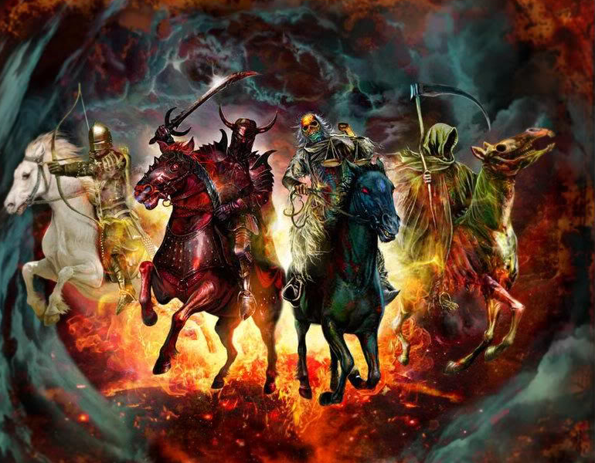
The Four Riders
Revelation 6:12-17 (NASB) I looked when He broke the sixth seal, and there was a great earthquake; and the sun became black as sackcloth made of hair, and the whole moon became like blood; and the stars of the sky fell to the earth, as a fig tree casts its unripe figs when shaken by a great wind. The sky was split apart like a scroll when it is rolled up, and every mountain and island were moved out of their places. Then the kings of the earth and the great men and the commanders and the rich and the strong and every slave and free man hid themselves in the caves and among the rocks of the mountains; and they *said to the mountains and to the rocks, "Fall on us and hide us from the presence of Him who sits on the throne, and from the wrath of the Lamb; for the great day of their wrath has come, and who is able to stand?"
Revelation 6:9-11 (NASB) When the Lamb broke the fifth seal, I saw underneath the altar the souls of those who had been slain because of the word of God, and because of the testimony which they had maintained; and they cried out with a loud voice, saying, "How long, O Lord, holy and true, will You refrain from judging and avenging our blood on those who dwell on the earth?" And there was given to each of them a white robe; and they were told that they should rest for a little while longer, until the number of their fellow servants and their brethren who were to be killed even as they had been, would be completed also.
Revelation 6:1-2 Then I saw when the Lamb broke one of the seven seals, and I heard one of the four living creatures saying as with a voice of thunder, "Come.“
I looked, and behold, a white horse, and he who sat on it had a bow; and a crown was given to him, and he went out conquering and to conquer.
(NLT) When the Lamb broke the second seal, I heard the second living being say, “Come!” Then another horse appeared, a red one. Its rider was given a mighty sword and the authority to take peace from the earth. And there was war and slaughter everywhere.
Revelation 6:7-8 (NASB) When the Lamb broke the fourth seal, I heard the voice of the fourth living creature saying, "Come." I looked, and behold, an ashen horse; and he who sat on it had the name Death; and Hades was following with him. Authority was given to them over a fourth of the earth, to kill with sword and with famine and with pestilence and by the wild beasts of the earth.
Revelation 6:5-6 (NLT) When the Lamb broke the third seal, I heard the third living being say, “Come!” I looked up and saw a black horse, and its rider was holding a pair of scales in his hand. And I heard a voice from among the four living beings say, “A loaf of wheat bread or three loaves of barley will cost a day’s pay. And don’t waste the olive oil and wine.”

Slide 3
The Four Riders
A Great Ruler
Global unity
The Cult of Man.
Peaceful Conquest
“All men's problems were created by man, and can be solved by man.” – J.F. Kennedy
World Ruler
Notes:
** “Great” = ** Unity → **Peaceful → **CULT..Man
** Kenedy

Slide 4
The Four Riders
Globalization Pressure
Economic Instabilities
War, unrest
Population, Mas Migration
Ecological Threats
World Ruler
Notes:
INEVITABLE → E.U. = STRUGGLING w/ Weak Authority
~B4!!!

Slide 5
The Four Riders
History of Man
WMD
Global War
Its rider was given a mighty sword and the authority to remove peace from the earth. And there was war and slaughter everywhere.
World Ruler
War
Notes:
Unity → WAR = HEART of MAN ** +WMD=Catastrophic
→ ~b4!!!

Slide 6
The Four Riders
“A loaf of wheat bread or three loaves of barley will cost a day’s pay. And don’t waste the olive oil and wine.”
Injustice & Greed
World Ruler
War
Famine
Notes:
MOVIE → HIS SOLUTIONS = IMPOSSIBLE **INJUSTICE/GREED

Slide 7
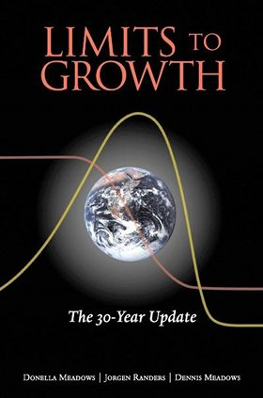
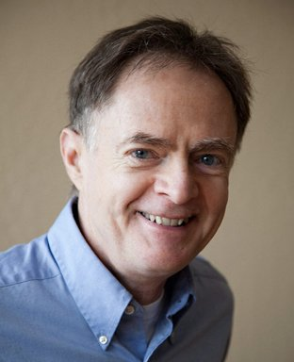
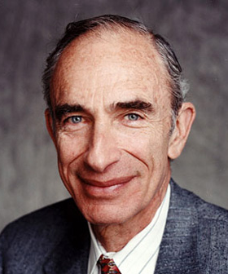
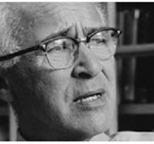
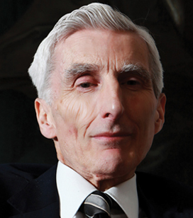
The Four Riders
We do not have another 30 years to dither. Much will have to change if the ongoing overshoot is not to be followed by collapse during the twenty-first century.
Population ‘blooms’ (or periods of rapid growth) are nearly always followed by crashes and die-offs.
The biggest jump, from 5 to 10 billion in well under a century, is still ahead… [People are not] aware that if humanity fails to act, nature may end the population explosion for us –in very unpleasant ways –well before 10 billion is reached.
Meadows and Randers
(Environmental Professor at Dartmouth; Systems Management Professor at Univ. of New Hamphire)
Meadows, Donella, Jorgen Randers, and Dennis Meadows. Limits to Growth: The 30-Year Update. White River Junction, VT: Chelsea Green, 2004. Xvi.
I think human life is threatened as never before in the history of this planet. Not just by one peril, but by many perils that are all working together and coming to a head at about the same time.
I think the odds are no better than fifty-fifty that our present civilization on Earth will survive to the end of the present century.
Richard Heinberg
(American educator, journalist, economist)
Heinberg, Richard. The End of Growth: Adapting to Our New Economic Reality. Gabriola Island, B.C.: New Society, 2011. 15.
Paul Ehrlich
(Professor of Biology at Stanford University)
Ehrlich, Paul R., and Anne H. Ehrlich. The Population Explosion. New York: Simon and Schuster, 1990. 15-16.
George Wald
(Harvard Professor, Nobel Prize winning scientist)
Interview
Martin Rees
(Agnostic cosmologist and physicist; Cambridge since 2004)
Rees, Martin J. Our Final Hour: A Scientist's Warning : How Terror, Error, and Environmental Disaster Threaten Humankind's Future in This Century on Earth and beyond. New York: Basic, 2003. 8.
Its rider was named Death, and his companion was the Grave. These two were given authority over one-fourth of the earth, to kill with the sword and famine and disease and wild animals.
We also believe that if a profound correction is not made soon, a crash of some sort is certain. And it will occur within the lifetimes of many who are alive today.
The result of those simulations is, in nearly every scenario, overshoot and collapse of the planet’s economy and population.
Conquest
War
Famine
Death
Notes:
Earth=Faces CRISIS → LIKE NEVER B4!!
~JUST CRAZY BIBLE THUMPERS → SCIENTISTS

Slide 8
The Four Riders
Revelation 6:12-17 I looked when He broke the sixth seal, and there was a great earthquake; and the sun became black as sackcloth made of hair, and the whole moon became like blood; and the stars of the sky fell to the earth, as a fig tree casts its unripe figs when shaken by a great wind. The sky was split apart like a scroll when it is rolled up, and every mountain and island were moved out of their places.
Matthew 24:21-22 (NASB) "For then there will be a great tribulation, such as has not occurred since the beginning of the world until now, nor ever will. "Unless those days had been cut short, no life would have been saved; but for the sake of the elect those days will be cut short.
Rev. 6:15ff Then the kings of the earth and the great men and the commanders and the rich and the strong and every slave and free man hid themselves in the caves and among the rocks of the mountains; and they *said to the mountains and to the rocks, "Fall on us and hide us from the presence of Him who sits on the throne, and from the wrath of the Lamb; for the great day of their wrath has come, and who is able to stand?"
Conquest
War
Famine
Death
Notes:
Billions Die → Ez.38=6 Months 2 Bury Bodies
2Day=Makes Sense → My Parents ~Underst
** Mt.24 =GREAT Tribulat. → ~B4 Possible!
**Rev.6= “STOP!!”

Slide 9
Above & Beyond All Else…
Q: Where Is God?
A: Restraining & Saving
For the mystery of lawlessness is already at work; only he who now restrains will do so until he is taken out of the way. Then that lawless one will be revealed…
2 Thessalonians 2:6-8
“This gospel of the kingdom shall be preached in the whole world as a testimony to all the nations, and then the end will come.”
Matthew 24:14

Slide 10
Above & Beyond All Else…
Q: Where Are Believers?
A: Compromising
Matthew 24:10-12 "At that time many will fall away and will betray one another and hate one another. Many false prophets will arise and will mislead many. Because lawlessness is increased, most people's love will grow cold.
2 Thessalonians 2:3 Let no one in any way deceive you, for it will not come unless the apostasy comes first…
Luke 18:8 “when the Son of Man comes, will He find faith on the earth?”
Matthew 5:13 "You are the salt of the earth; but if the salt has become tasteless, how can it be made salty again? It is no longer good for anything, except to be thrown out and trampled under foot by men.
Notes:
**Mt.24 =Hard Time 2b Xian
**2Th. = FALLING AWAY Frm WOG → Lk.18 “??ACTS Like It’s REAL??”
Mt.5 SALT=PRESERV. Influence → Cease 2b? → “w/o FLAVOR”
= “USELESS, TRAMPLED Under Foot” = Xians Today

Slide 11
Above & Beyond All Else…
Q: Is This TRUE?
A: More Than Ever
Matthew 24:10-12 "At that time many will fall away and will betray one another and hate one another. Many false prophets will arise and will mislead many. Because lawlessness is increased, most people's love will grow cold.
Falling Away:
80% of Christian Kids Leaving
20+ Million Christians Drifting Aimlessly
Betrayal / Hatred
50% Divorce – Same with Christians
More Single Parents Than Married Parents
Lawlessness Increased
Majority of Evangelicals Don’t Believe in Absolutes
Postmodern/PC “Religion” & “Emergent” Church
Cold-Hearted ‘Love’
Sex-Love
Me-First Love

Slide 12
What Does It Mean?
1 Thes. 5:3-9 While they are saying, "Peace and safety!" then destruction will come upon them suddenly like labor pains upon a woman with child, and they will not escape.
But you, brethren, are not in darkness, that the day would overtake you like a thief; for you are all sons of light and sons of day. We are not of night nor of darkness; so then let us not sleep as others do, but let us be alert and sober.
…But since we are of the day, let us be sober, having put on the breastplate of faith and love, and as a helmet, the hope of salvation.
For God has not destined us for wrath, but for obtaining salvation through our Lord Jesus Christ,
Don’t Sleep
Don’t Blend In
Fight for God’s Kingdom
Notes:
“But YOU” = DIFF. WORLD → ~Excuse!! → Lukewarm=Laodician Xianity
AP: SOBER → FIGHT-KILLER
“Faith…Love” → FULFILLED/Meaningful Life → ~Typical USA Xian
APP: >30 CROWD = LULLED 2 SLEEP

Slide 13
What Does It Mean?
2 Peter 3:10-11 But the day of the Lord will come like a thief, in which the heavens will pass away with a roar and the elements will be destroyed with intense heat, and the earth and its works will be burned up. Since all these things are to be destroyed in this way, what sort of people ought you to be in holy conduct and godliness,
Matthew 5:13 if the salt has become tasteless…It is no longer good for anything
Don’t Sleep
Don’t Blend In
Fight for God’s Kingdom
Notes:
2Pe.3 → DIFFERENT = LOVING / CARING / DOING GOOD
**MT.5 Tasteless = USELESS XIANS =EVERYWHERE
AP: LUK 4 Ways 2 B DIFFERENT!!

Slide 14
What Does It Mean?
Psalm 2:1 Why do the nations rage…?
Hebrews 12:4 You have not yet resisted to the point of shedding blood in your striving against sin;
Don’t Sleep
Don’t Blend In
Fight!
Notes:
RAGE=All Around Us…Have 2 Fight 4 Something → IL: MARS ATTACKS
**He.2 We=Pussies
AP: FIGHT W/$$,TIME,RESOURCES, BRAINS, DEGREES
AP: THIS SIDE ^ THAT SIDE

Slide 15
What Does It Mean?
Revelation 6:9-11 When the Lamb broke the fifth seal, I saw underneath the altar the souls of those who had been slain because of the word of God, and because of the testimony which they had maintained; and they cried out with a loud voice, saying, "How long, O Lord, holy and true, will You refrain from judging and avenging our blood on those who dwell on the earth?" And there was given to each of them a white robe; and they were told that they should rest for a little while longer, until the number of their fellow servants and their brethren who were to be killed even as they had been, would be completed also.
2 Timothy 4:6 For I am already being poured out as a drink offering, and the time of my departure has come.
Don’t Sleep
Don’t Blend In
Fight!
Notes:
Rev.6 Mid-Trib.=FIGHTERS (=Jewish Xians)
G’s Answ=“More Must DIE” → SACRIFICE = Altar **2Ti.4:6
2Day=Xians Lost the Will 2 Fight

Slide 17
The Revelation of “Jesus the Carpenter”
Revelation 5:1-3 (NASB) I saw in the right hand of Him who sat on the throne a book written inside and on the back, sealed up with seven seals. And I saw a strong angel proclaiming with a loud voice, "Who is worthy to open the book and to break its seals?" And no one in heaven or on the earth or under the earth was able to open the book or to look into it.
Revelation 5:4 (NASB) Then I began to weep greatly because no one was found worthy to open the book or to look into it;
Rules the Course of History
The Only Worthy Ruler in History
Rules Beyond Our Tragic History
Revelation 5:6-9 And I saw between the throne and the elders a Lamb standing, as if slain…And He came and took the book…And they *sang a new song, saying, "Worthy are You to take the book and to break its seals; for You were slain, and purchased for God with Your blood men from every tribe and tongue and people and nation…

Slide 18
The Revelation of “Jesus the Carpenter”
Revelation 5:11-13 I heard the voice of many angels around the throne and the living creatures and the elders; and the number of them was myriads of myriads, saying with a loud voice, "Worthy is the Lamb that was slain to receive power and riches and wisdom and might and honor and glory and blessing."
And every created thing which is in heaven and on the earth and under the earth and on the sea, and all things in them, I heard saying, "To Him who sits on the throne, and to the Lamb, be blessing and honor and glory and dominion forever and ever."
Rules the Course of History
The Only Worthy Ruler in History
Rules Beyond Our Tragic History

Slide 19
The Revelation of “Jesus the Carpenter”
Hebrews 2:8-9 (ESV) Now in putting everything in subjection to him, he left nothing outside his control. At present, we do not yet see everything in subjection to him.
But we see him who for a little while was made lower than the angels, namely Jesus, crowned with glory and honor because of the suffering of death, so that by the grace of God he might taste death for everyone.
Rules the Course of History
The Only Worthy Ruler in History
Rules Beyond Our Tragic History

Slide 20
What Does It Mean?
Don’t Sleep
Don’t Blend In
Fight for God’s Kingdom

Slide 21
Above & Beyond All Else…
Where Is God?
For the mystery of lawlessness is already at work; only he who now restrains will do so until he is taken out of the way. Then that lawless one will be revealed…
2 Thessalonians 2:6-8 (NASB)
Hebrews 12:26-27 (NASB) He has promised, saying, "YET ONCE MORE I WILL SHAKE NOT ONLY THE EARTH, BUT ALSO THE HEAVEN." This expression, "Yet once more," denotes the removing of those things which can be shaken, as of created things, so that those things which cannot be shaken may remain.

